Slide 1
BSbusters

Slide 2
We need to talk about bias news...

Slide 4
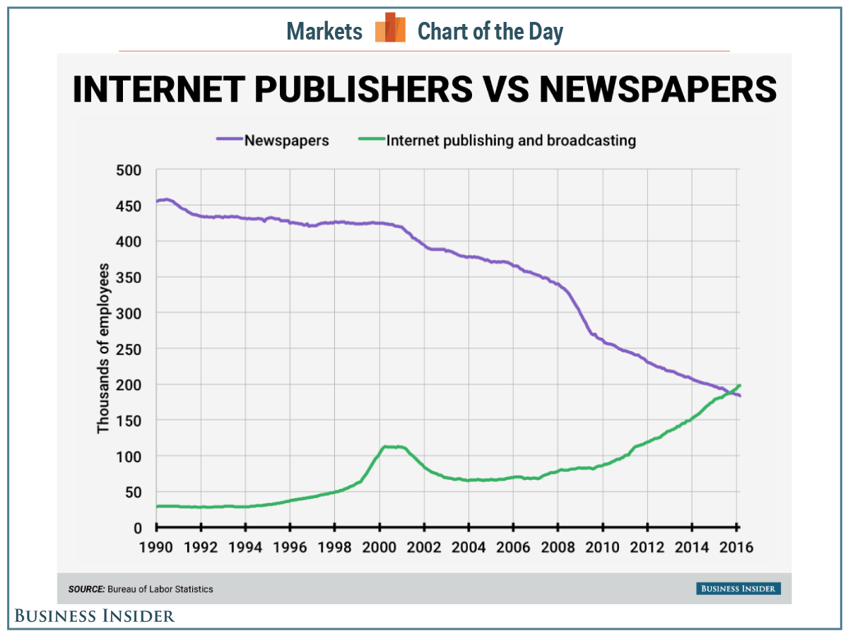
The shift of the newspaper to the internet publishing

Slide 5
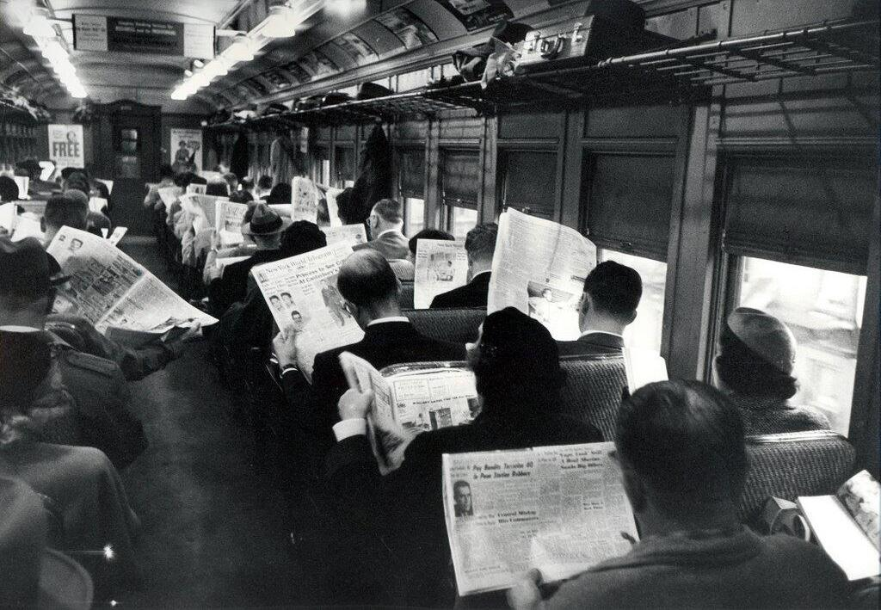
‘The need for reliable, unbiased information’

Slide 6
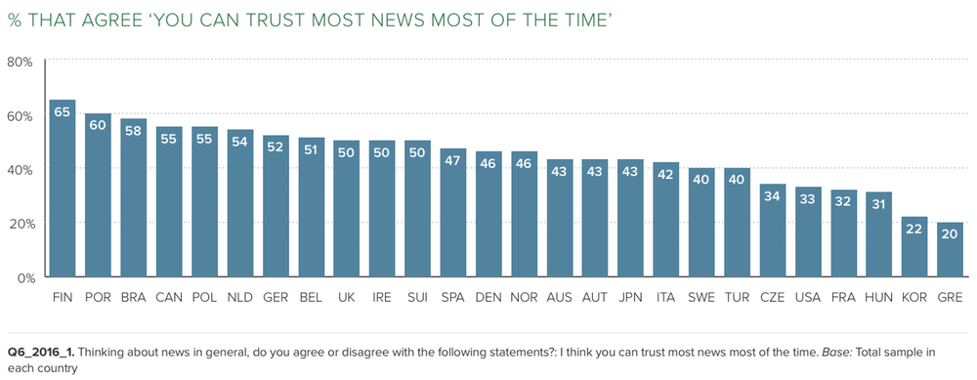
Biased News

Slide 7
The Problem?

Slide 8
Many people overlook the publisher’s socio-political tendencies which consequently have an impact on the understanding of the information portrayed

Slide 9
We are less likely to expend energy verifying a quote which confirms our political beliefs, an effect which psychologists call confirmation bias
Kim LaCapria (Snopes)

Slide 10

Confirmation bias
Confirmation bias is the tendency to search for, interpret, favor, and recall information in a way that confirms one's preexisting beliefs or hypotheses

Slide 11

A news story can be shared by millions of readers
A complex idea can be conveyed with just a single still image, namely making it possible to absorb large amounts of data quickly.

Slide 12
SOLUTION
A platform where users can view bias in articles they’re reading

Slide 13
NEWS .ai
Innovative new tool that allows users to quickly and easily view political bias behind a news story.

Slide 14
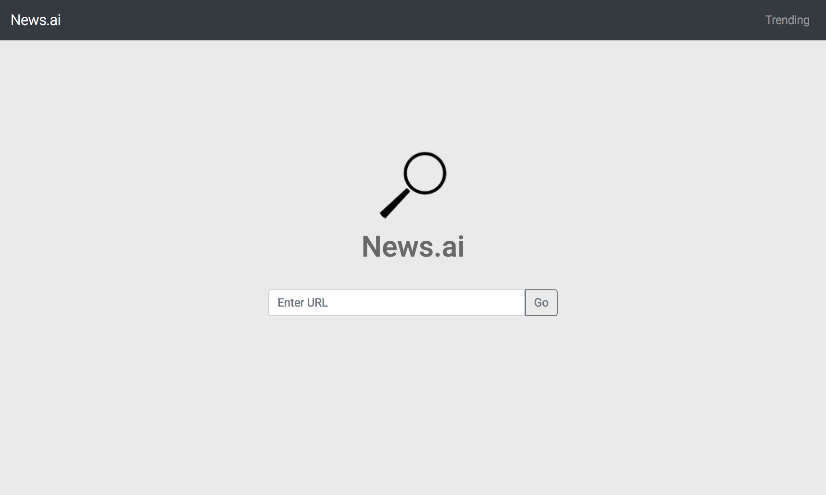
DESKTOP WEB APP
User friendly interface that prompts the user for an URL and analyses the content on that page returning a brief with the analysis data
Place your screenshot here

Slide 15
Why do we do this?
We believe people should have the right to know whether the media is trustworthy or not

Slide 16
How do we plan on doing this?

Slide 17
THANKS!
Any questions?
You can find me at:
@username
user@mail.me

